Slide 1
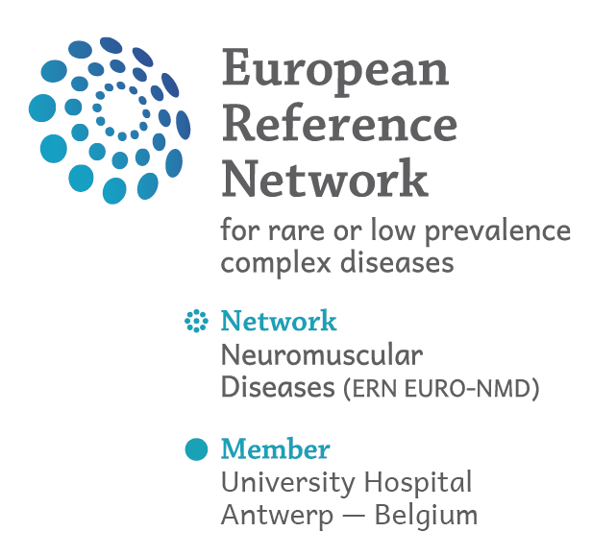
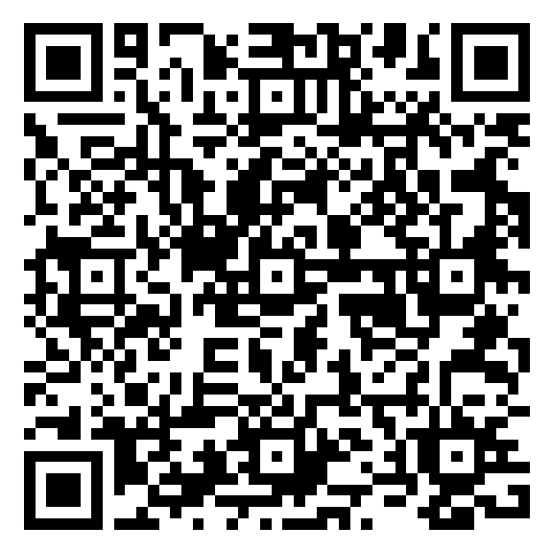


Questionnaire for people living
with ALS and their carers:
Share your experience!
Why participate?
Your contribution will help us…
Identify gaps in care and support
Capture the lived experiences and needs of patients and carers
Improve and harmonise ALS care across Europe
Who can take part?
People living with ALS
You can respond on behalf of a patient or a patient community
Family members or carers supporting a person living with ALS
In all European countries (EU or non-EU)
Scan this QR code to access the questionnaire!
Anonymous and voluntary
Available in 32 languages
Deadline: 30 April 2026
Your voice matters
Feel free to share this with others who may be concerned!
This initiative is led by the European Reference Network for Rare Neuromuscular Diseases (ERN EURO-NMD), within the framework of the JARDIN Joint Action (Task 6.2)
https://ern-euro-nmd.eu/breaking-news/questionnaire-for-people-living-with-als-and-their-carers-share-your-experience/

